Slide 1
Design and Analysis of Algorithm (KCS503) Getting Started Lecture - 1

Slide 2
Overview
Start using frameworks for describing and
analyzing algorithms.
• Examine algorithms :
simple algorithms
insertion sort
• See how to describe algorithms in pseudo code.
• Begin using asymptotic notation to express
running-time analysis.

Slide 3
Overview
Start using frameworks for describing and analysing algorithms.
Examine algorithms :
simple algorithms
Sorting algorithm insertion sort
See how to describe algorithms in pseudo code.
Begin using asymptotic notation to express running-time analysis.

Slide 4
What is an Algorithm ?
An algorithm is any well defined computational procedure that takes some value or set of values, as input and produces some value or set of values as output.
We can also view an algorithm as a tool for solving a well specified computational problem.

Slide 5
Characteristics of an Algorithm
Input: provided by the user.
Output: produced by algorithm.
Definiteness: clearly define.
Finiteness: It has finite number of steps.
Effectiveness: An algorithm must be effective so that it’s output can be carried out with the help of paper and pen.

Slide 6
Analysis of an Algorithm
It deals with predicting the resources that an algorithm requires to its completion such as memory and CPU time.
To main measure for the efficiency of an algorithm are Time and space.

Slide 7
Complexity of an Algorithm
Complexity of an Algorithm is a function, f(n) which gives the running time and storage space requirement of the algorithm in terms of size n of the input data.
Space Complexity: Amount of memory needed by an algorithm to run its completion.
Time complexity: Amount of time that it needs to complete itself.

Slide 8
Cases in Complexity Theory
Best Case: Minimum time
Worst Case: Maximum amount of time
Average Case: Expected / Average value of the function f(n).

Slide 9
Example 1
A()
{
int i;
for(i=1;i<=n;i++)
{
printf(“ABCD”);
}
}

Slide 10
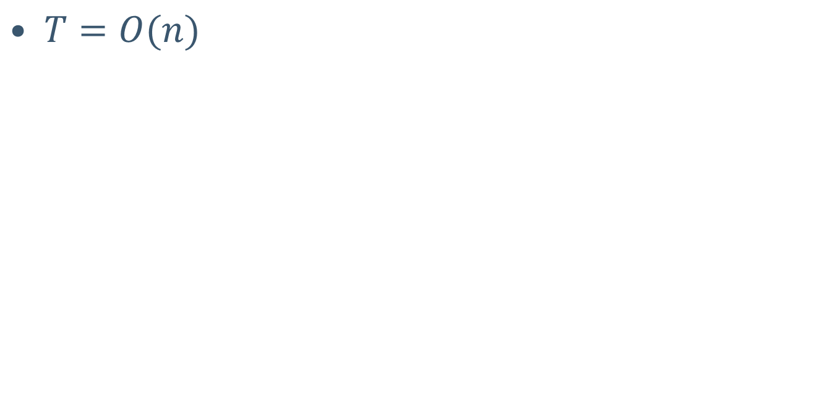
Complexity of Example 1

Slide 11
Example 2
A()
{
int i=1 ,s=1;
scanf(“%d”, &n);
while(s<=n)
{
i++;
s=s+i;
printf(“abcd”);
}
}

Slide 12
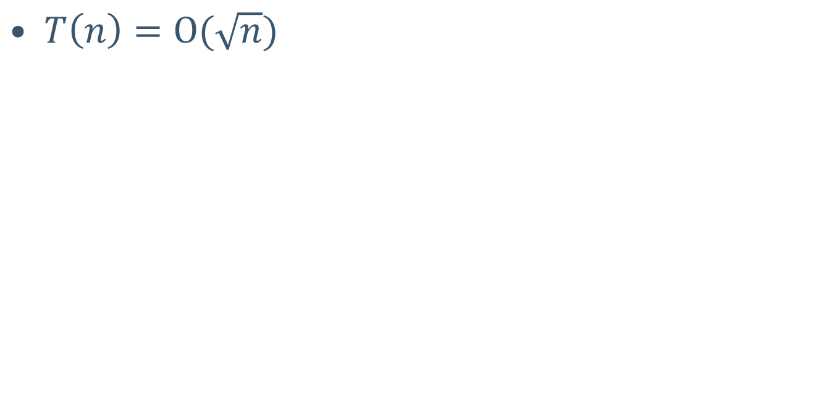
Complexity of Example 2

Slide 13
Example 3
A()
{
int i=1;
for(i=1; i pow 2<=n; i++)
{
printf(“abcd”);
}
}

Slide 14

Complexity of Example 3

Slide 15

Example 4
$$A()$$
$$\{$$
$$int i=1;$$
$$for(i=1;i≤n; i++)$$
$$\{$$
$$for(j=1;j≤i^{2}; j++)$$
$$\{$$
$$for(k=1;k≤n/2;k++)$$
$$\{$$
$$printf(“abcd”);$$
$$\}$$
$$\}$$
$$\}$$
$$\}$$

Slide 16
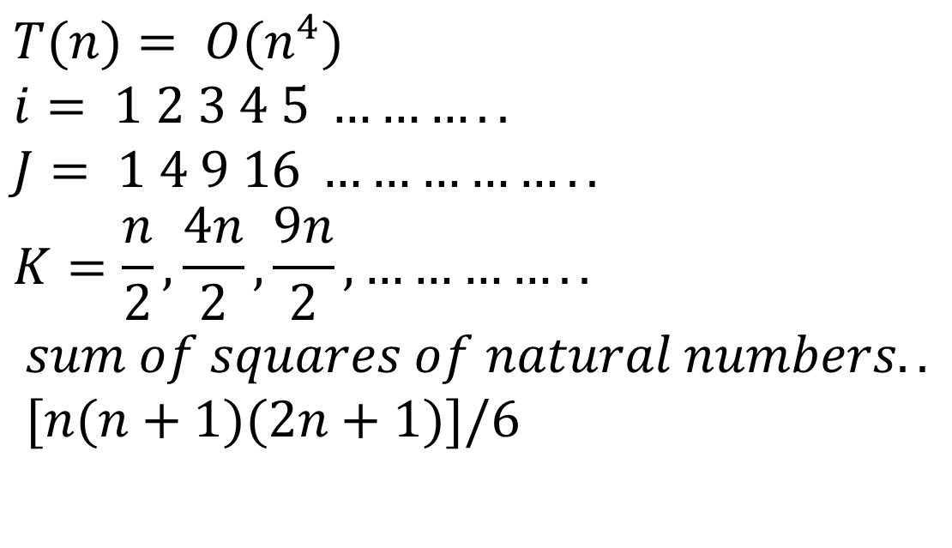
Complexity of Example 4
$$T(n)= O(n^{4})$$
$$i= 1 2 3 4 5 ………..$$
$$J= 1 4 9 16 ……………..$$
$$K=\frac{n}{2},\frac{4n}{2},\frac{9n}{2}, …………..$$
$$sum of squares of natural numbers..$$
$$[n(n+1)(2n+1)]/6$$

